Slide 1

HOUSE RENTAL
DATABASE SYSTEM
TEAM 11
Eesita Sen
Srujana Adapa
Durga Sreshta Kamani
Sathwik Reddy Chelemela
Saneeth Reddy Depa
April 2024

Slide 2

PROJECT OVERVIEW
Goal of this project is to design and implement a comprehensive database system for a house rental property business
This database will streamline the management and discovery of rental properties, focusing on both the business needs and those of the customers.
HIGHLIGHTS
Entities and Relationships: The database contains multiple interrelated entities, including Users, Landlords, Management Companies, Customers/Renters, Leases, Payments, Property Details, Broker Firms, Brokers, and others.
Unique Identifiers: Each key entity (User, Property, Lease, etc.) has a unique identifier, ensuring data integrity and easy referencing.
Having primary key, foreign key, check constraints to keep the data consistent
Encryption is used to protect data from being stolen, changed, or compromised
Views are used to encapsulate common queries, allowing repeated use without redefining complex logic.
Triggers are created to automatically perform specific actions like inserting into audit logs
User-friendly interface which can perform all CRUD operations and used Stored-Procedures for backend activities
Visualization using Tableau to show data statistics.

Slide 3
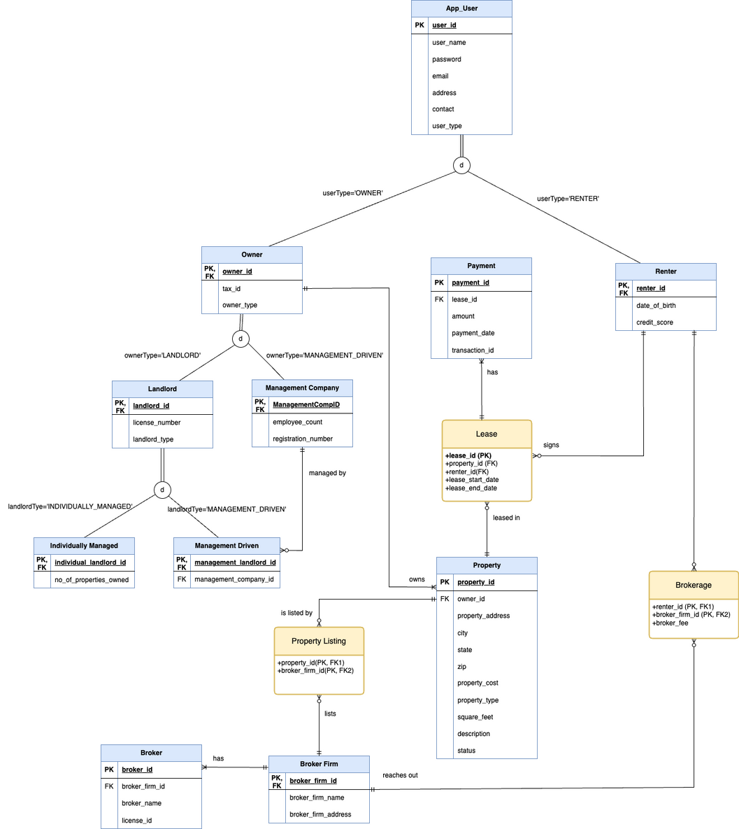
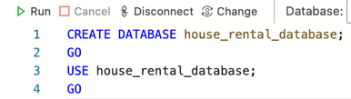
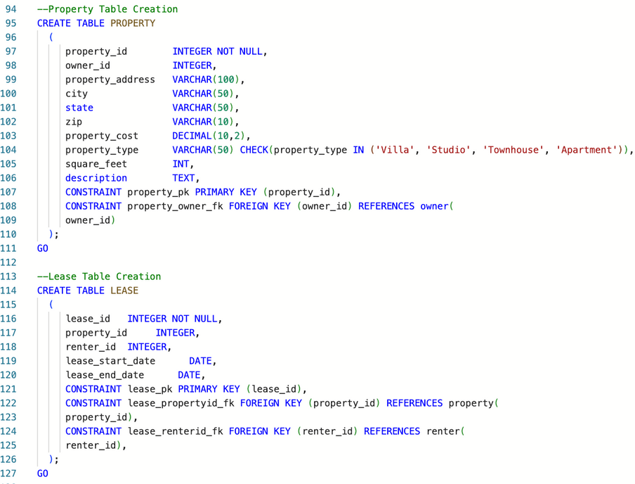

ERD
DDL
DML

Slide 4
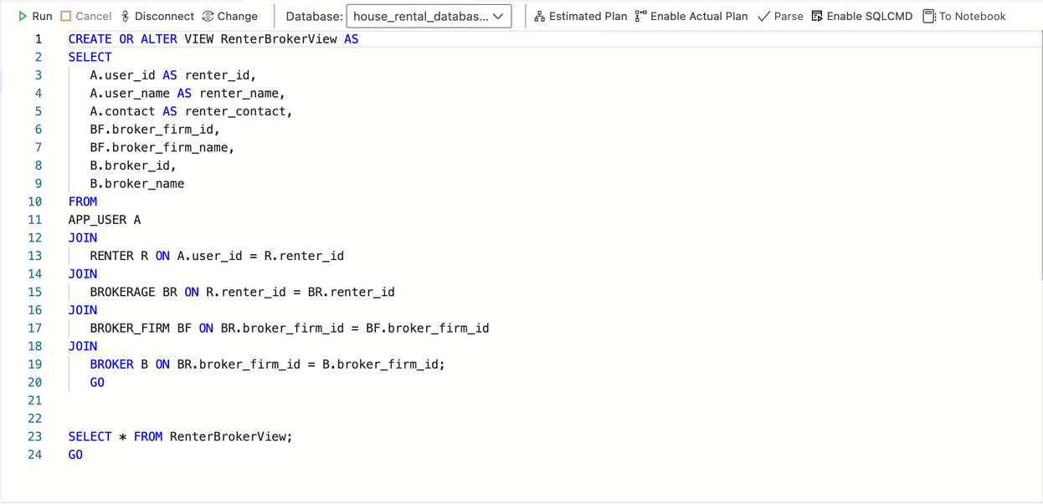
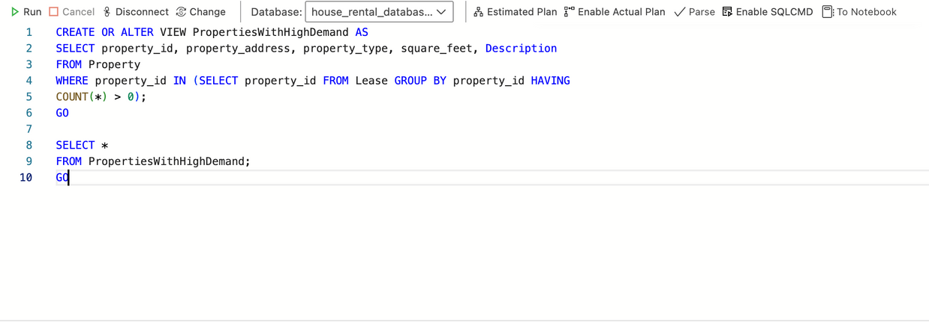
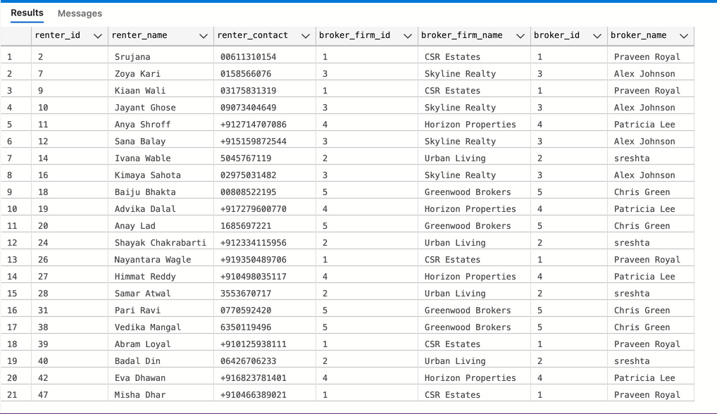
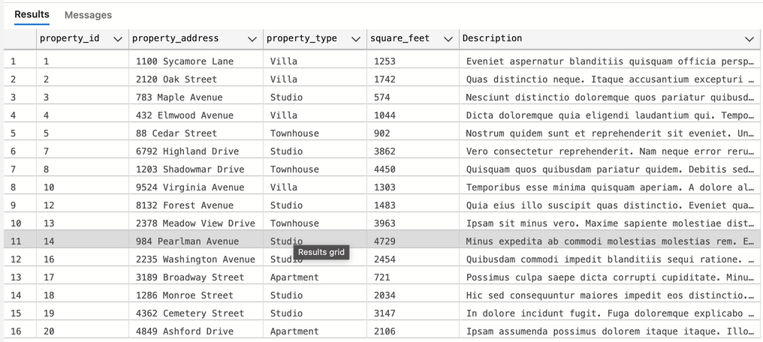
VIEW
VIEW1: View that shows all renters along with their broker firms and associated brokers
VIEW2: View to show Properties With High Demand
OUTPUT
OUTPUT

Slide 5
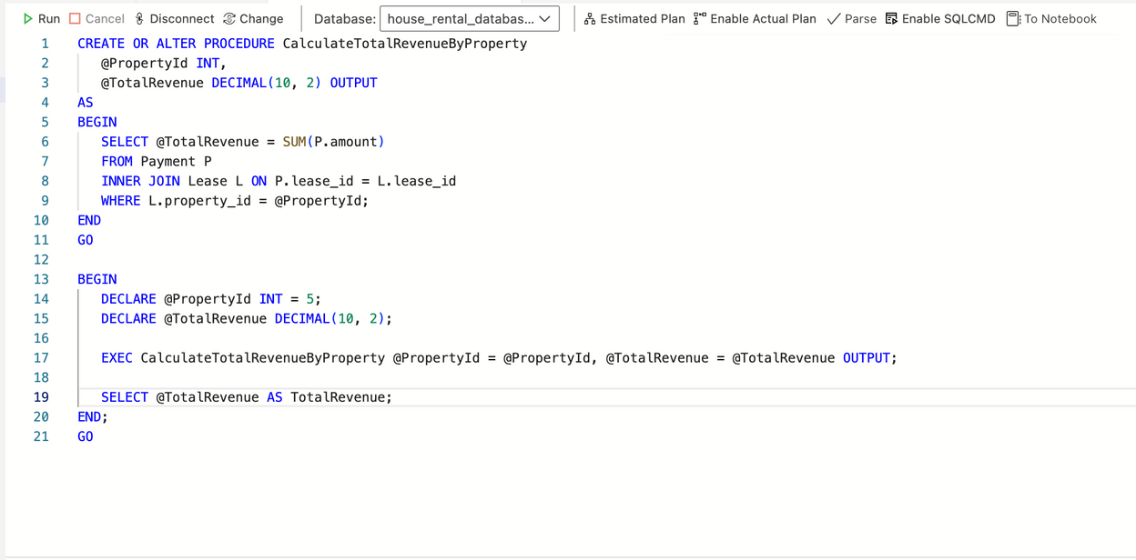
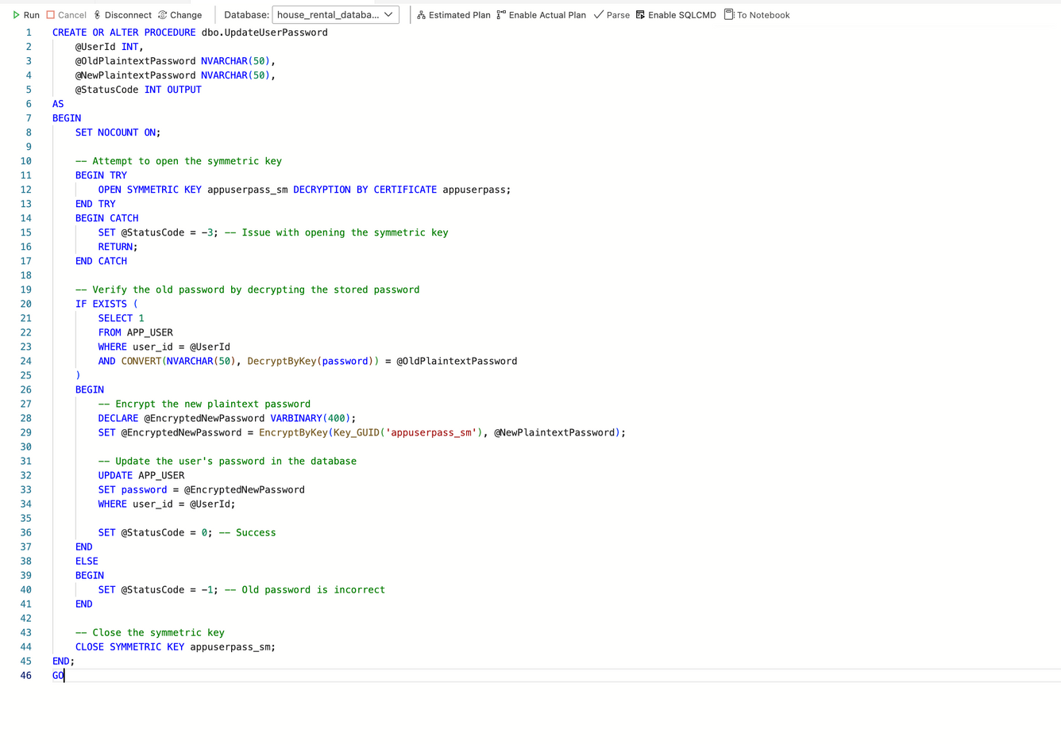
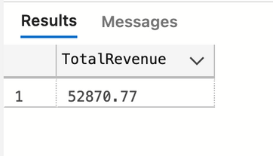
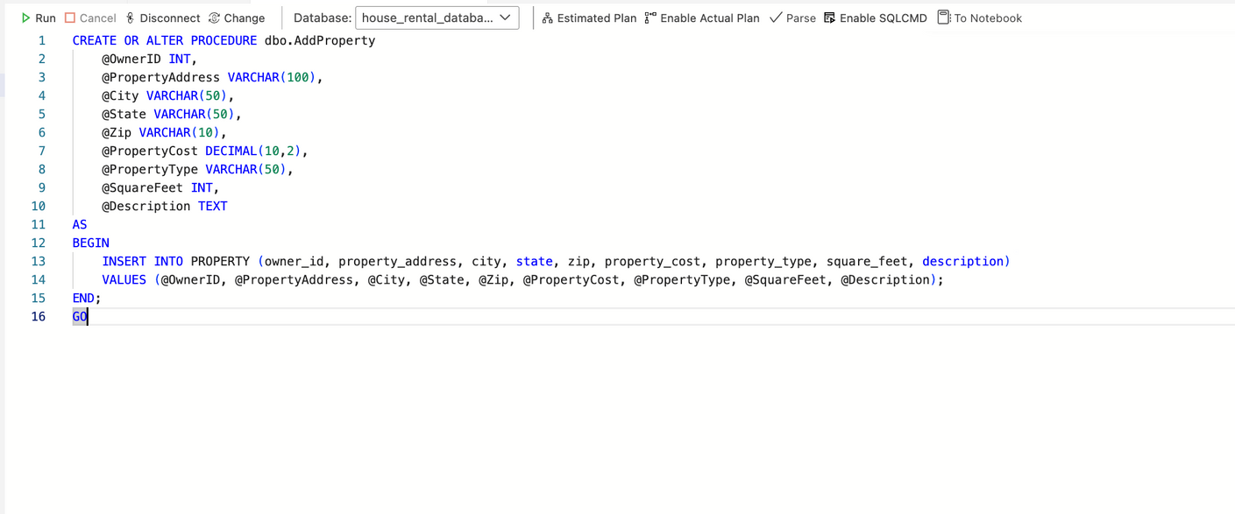
STORED PROCEDURE
Calculate Total Revenue by Property
Procedure to update user password
OUTPUT
Procedure to add a new property

Slide 6
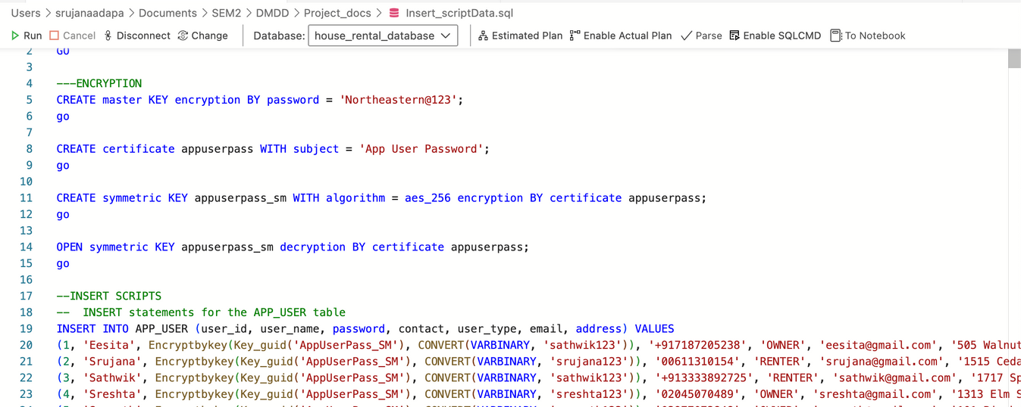
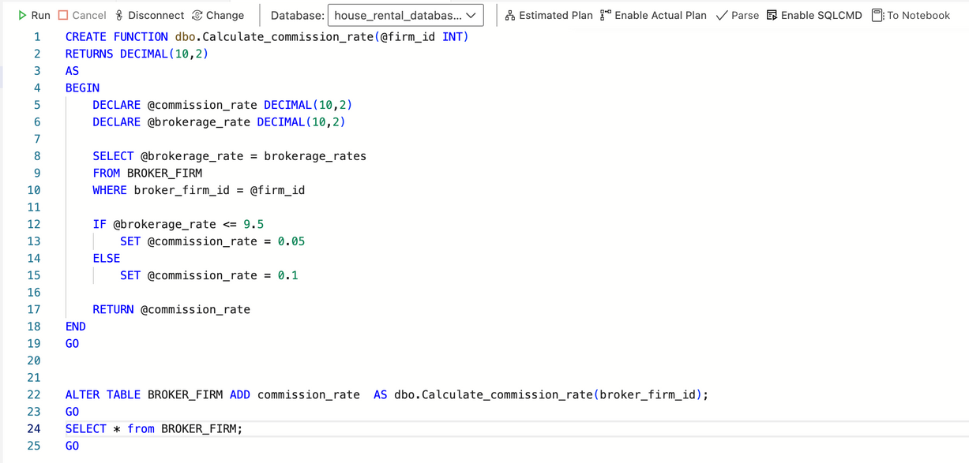
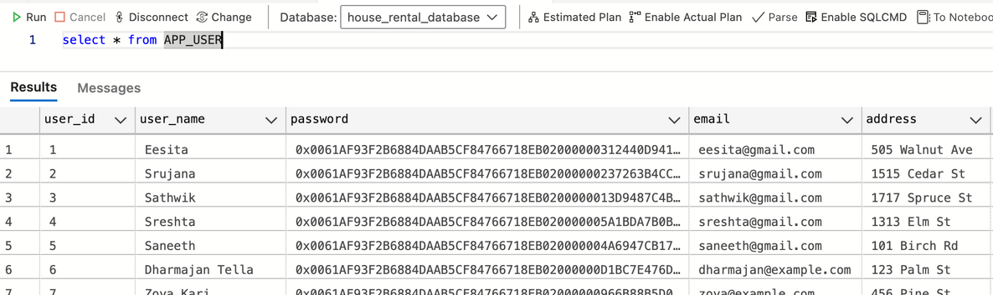
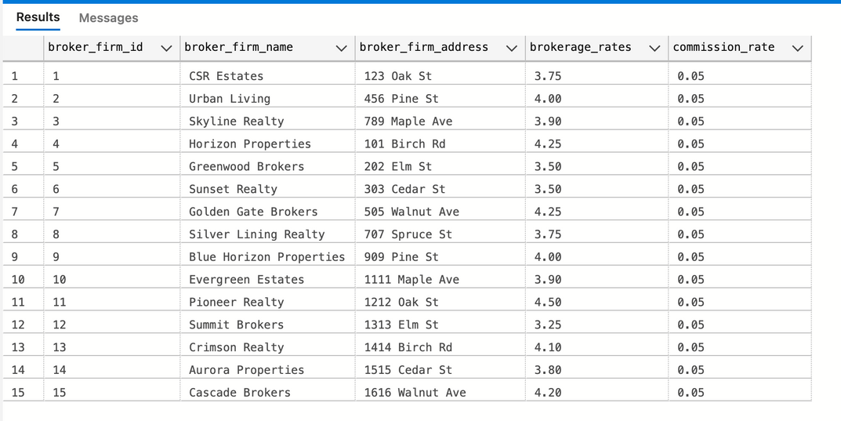

ENCRYPTION
USER DEFINED FUNCTION
A security framework within SQL Server involving a master key, a certificate, and a symmetric key to encrypt sensitive user password data.
Calculates commission rates of broker firms based on Brokerage Rates
NON-CLUSTERED INDEX
A non-clustered index is created on payment_date of the payment table, which optimizes search based on this column

Slide 7
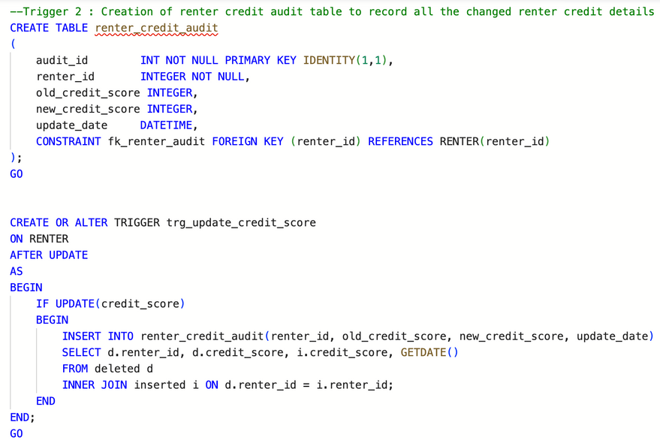

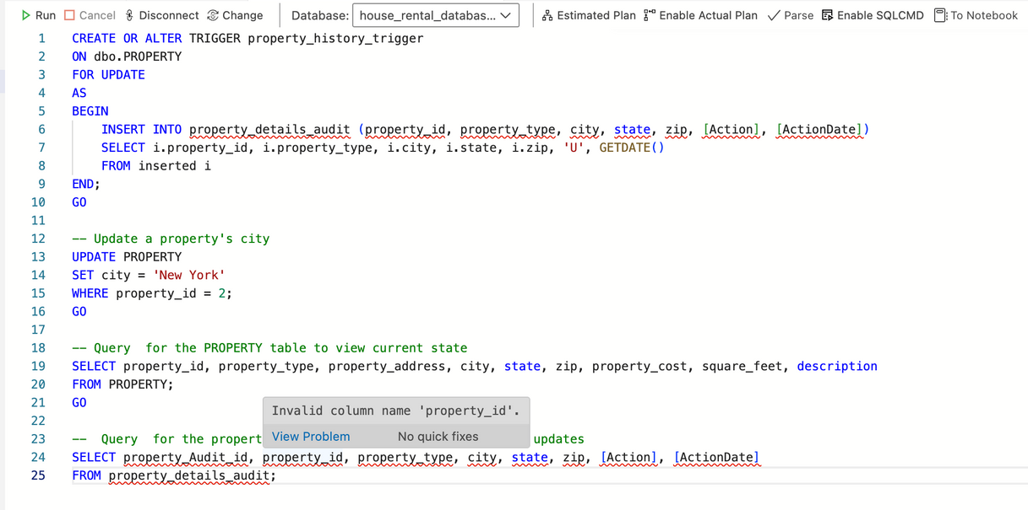
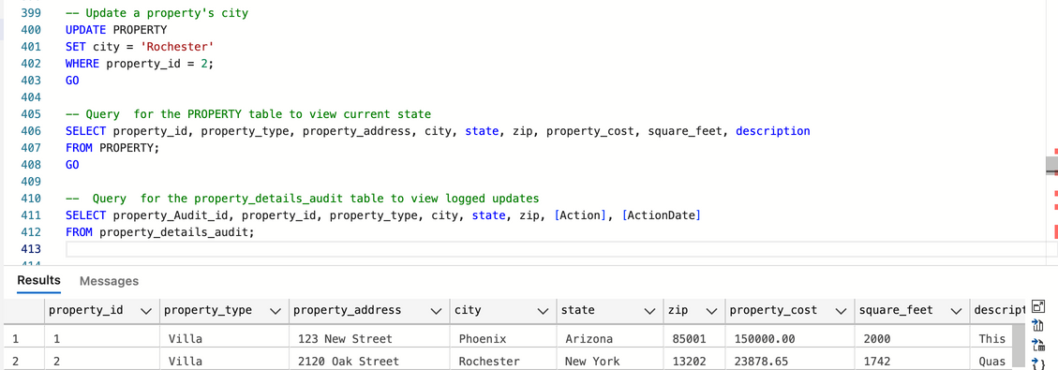
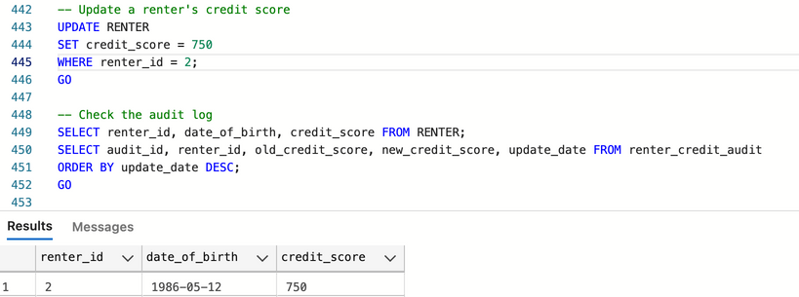
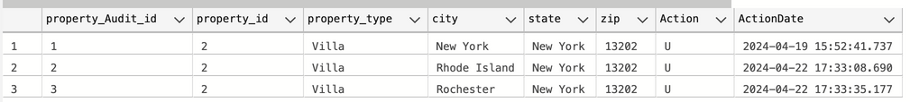
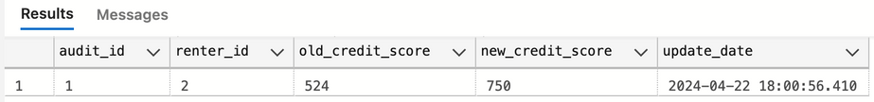
TRIGGER
TRIGGER 1: To add a row in the property_details_audit table which captures the current property detail changes on table PROPERTY
TRIGGER 2: To add a row in the renter_credit_audit table which capures old and new credit scores when the credit source is updated in the RENTER table
BEFORE
OUTPUT
OUTPUT

Slide 8
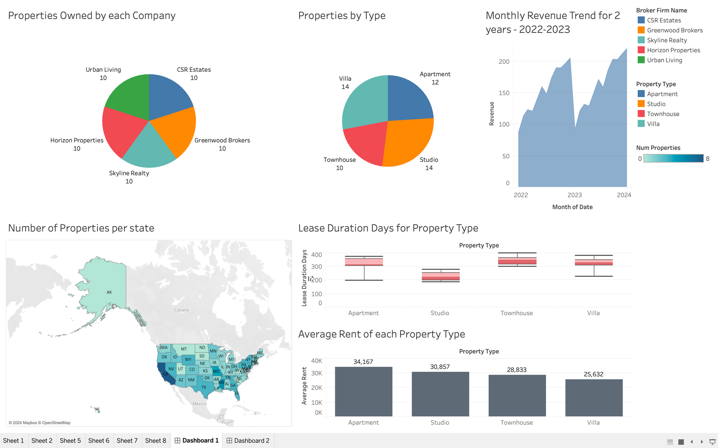
VISUALIZATIONS

Slide 9
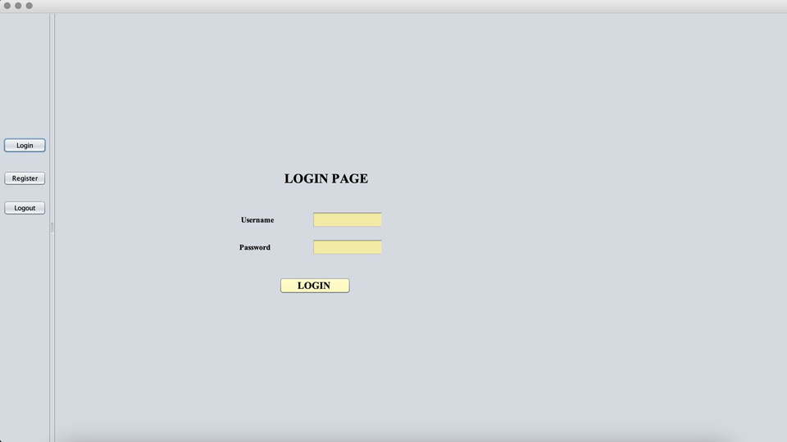
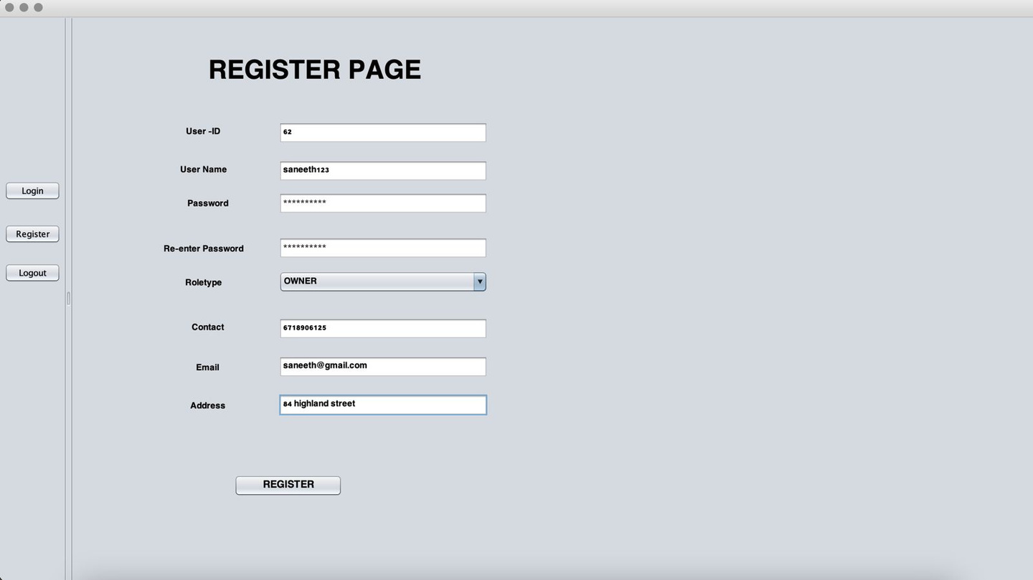
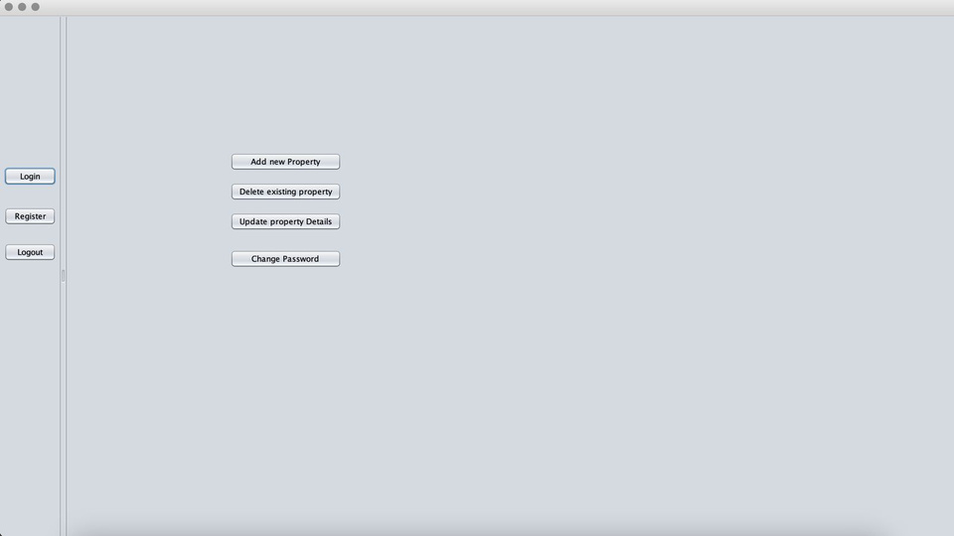
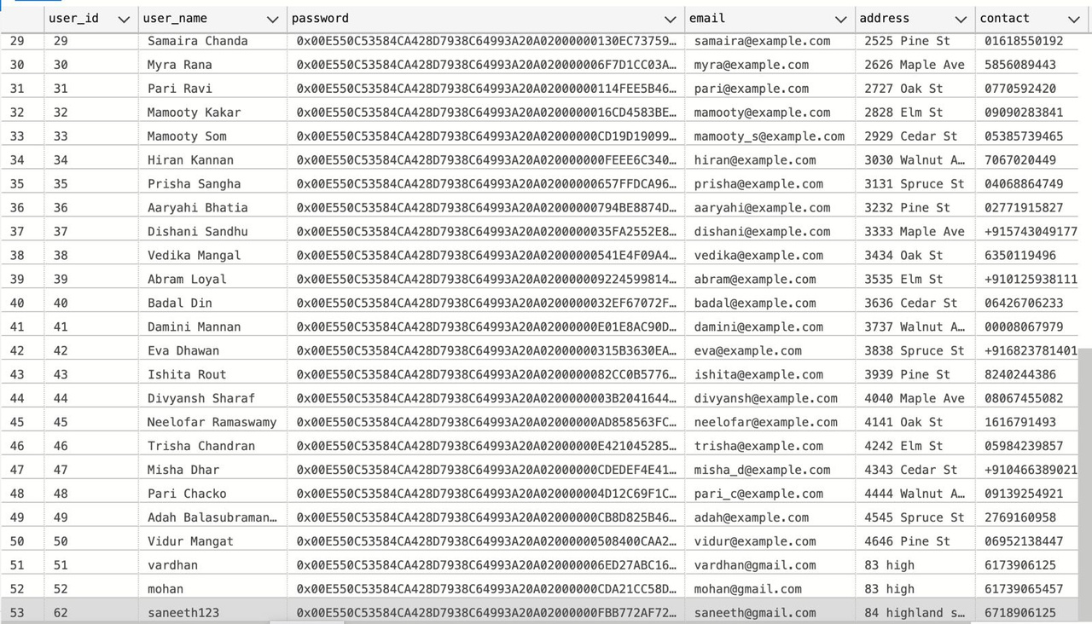
USER INTERFACE

Slide 10
THANK YOU

